Slide 1
PhotoBazaar​ Online artworks sharing & trading platform​
Shiyuan Xu
Xiaoxing Pan
Chang Liu
https://photobazaar.vercel.app

Slide 2
BACKGROUND
PhotoBazaar: digital marketplace where users can share, manage, and trade their original artworks
Seller – Upload & Manage​ment
Buyer – Search, Cart, Payment​
Communication – Text Chat​
Admin – Tags, Users, Artworks, Payment Track

Slide 3

TECHNOLOGIES
MERN(MongoDB, Express, React, Node.js)​
Tailwind​
Json web token, CORS, Axios​
AWS S3 Bucket​
Stripe​
Nodemailer​
Socket.io​
Vercel

Slide 4
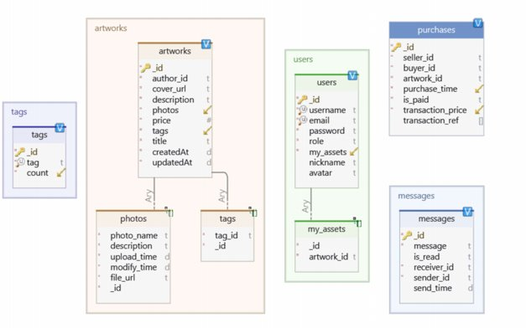
DATABASE- MONGODB

Slide 5
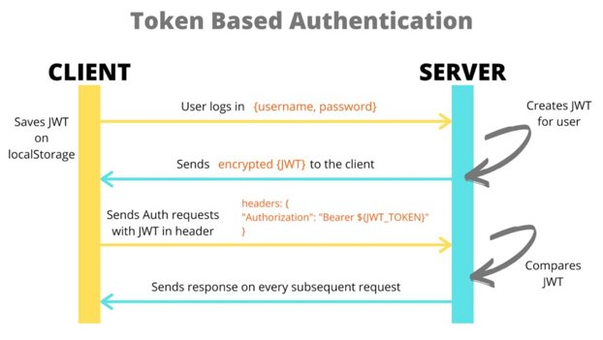
AUTHENTICATION-JWT

Slide 6
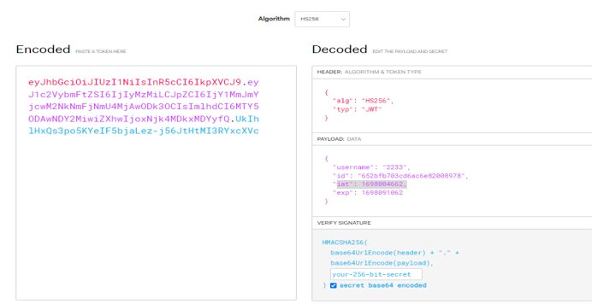
AUTHENTICATION-JWT

Slide 7
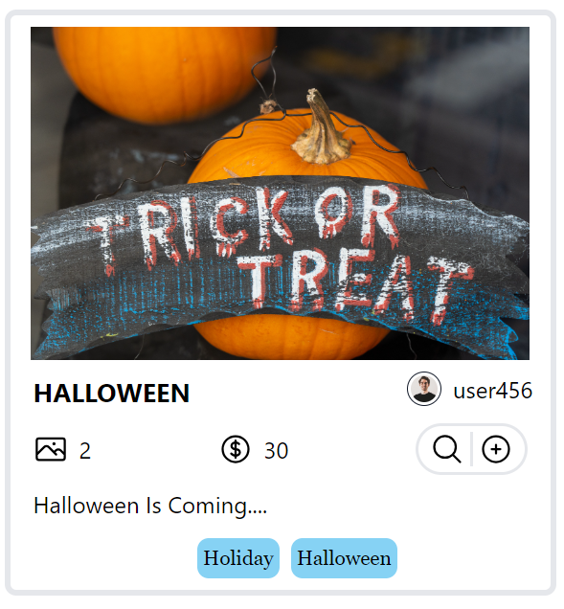
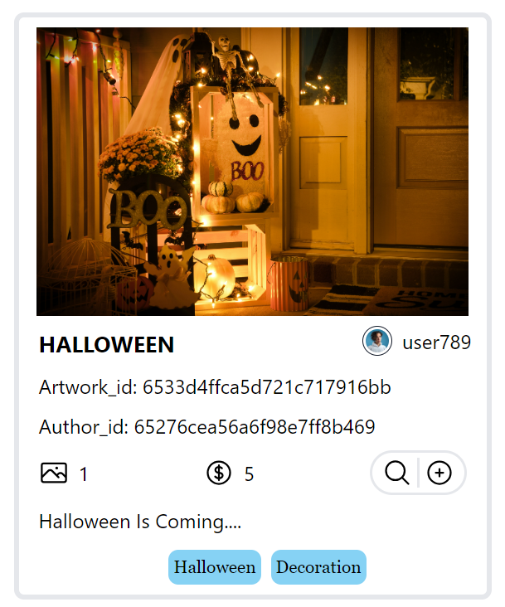
AHTHORIZATION: USER & ADMIN ROLE
USER ROLE
ADMIN ROLE

Slide 8
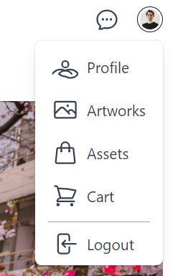
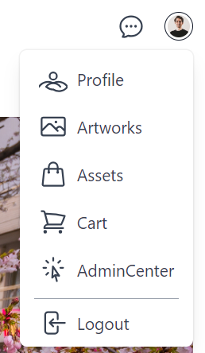
AHTHORIZATION: USER & ADMIN ROLE
USER ROLE
ADMIN ROLE

Slide 9
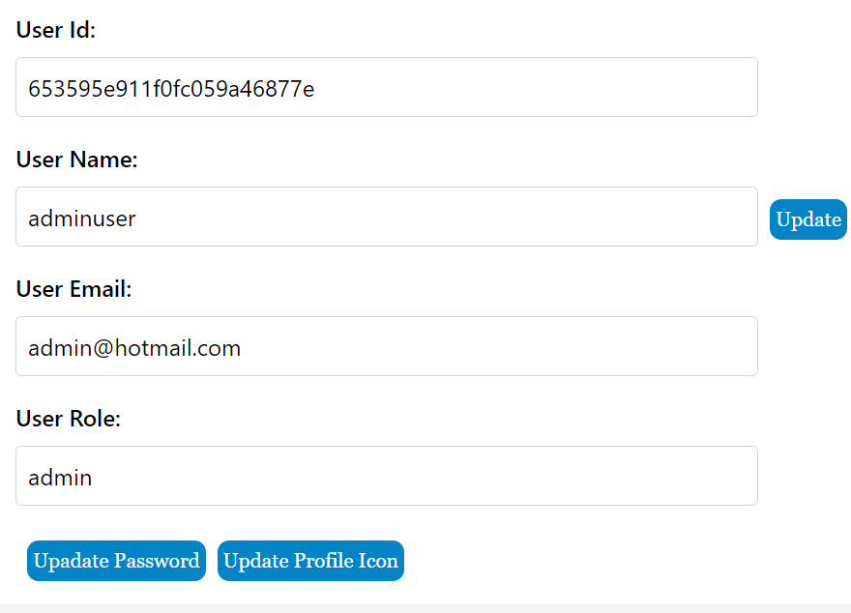
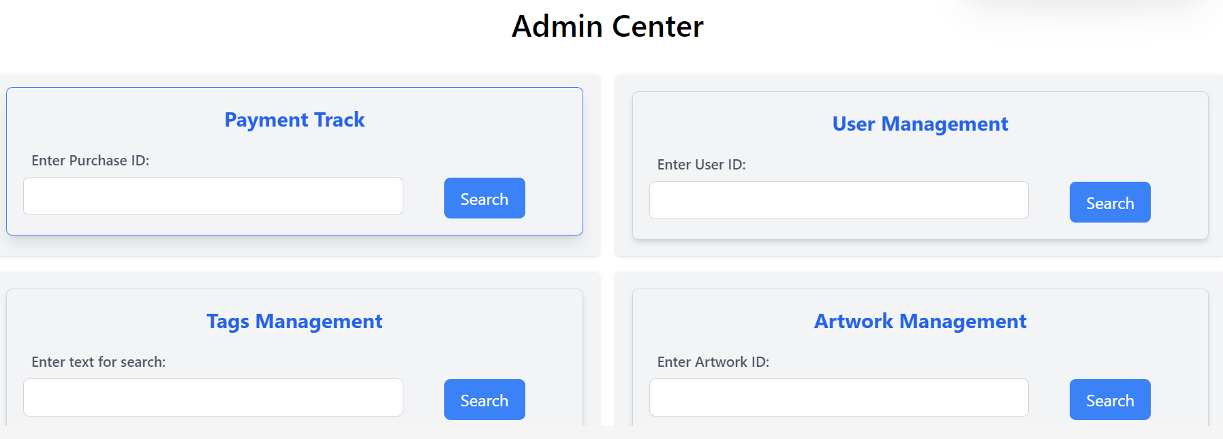
AHTHORIZATION: USER & ADMIN ROLE
USER PROFILE
ADMIN CENTER

Slide 10

RESET PASSWORD-NODEMAILER

Slide 11
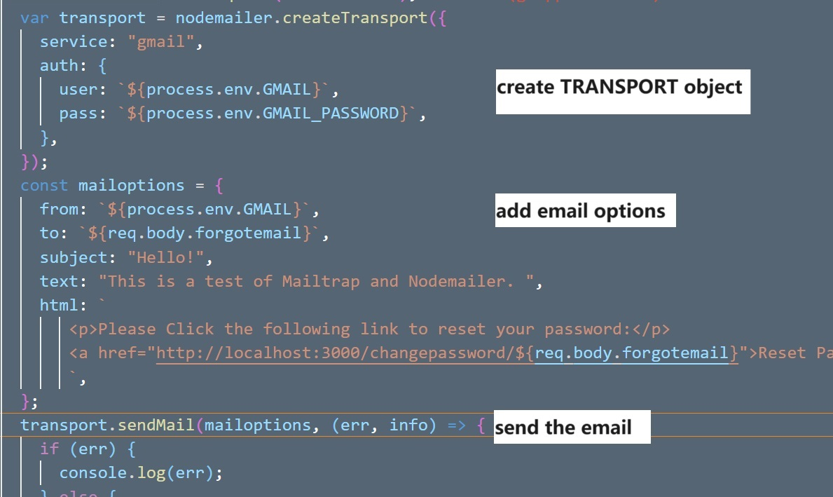
RESET PASSWORD-NODE MAILER

Slide 12
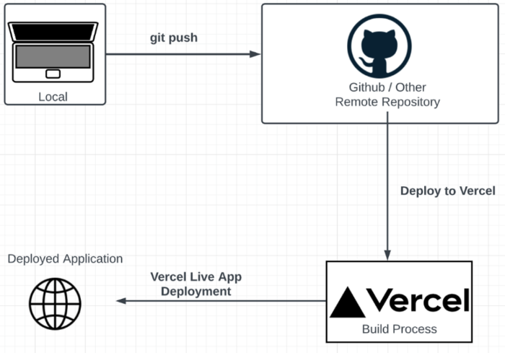
DEPLOY ON VERCEL

Slide 13


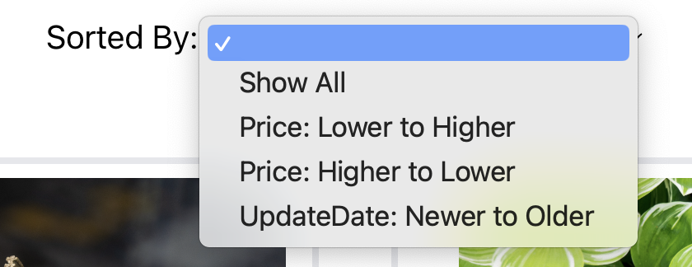
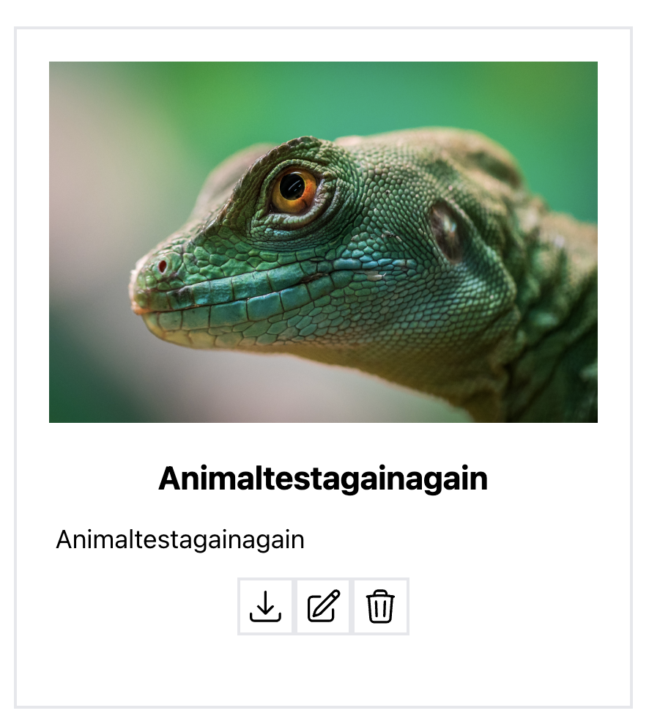
ARTWORK
Search => Tags/Keyword
Sort => All/Price/Update Date
Show => Home/My artworks/My assets
Edit => CRUD artwork
Details => CRUD photos
Other => Add to Cart/Download

Slide 14


Challenges & Solutions: Make component reusable
Search Box => Home page/Search Page
Home Page
Search Page

Slide 15
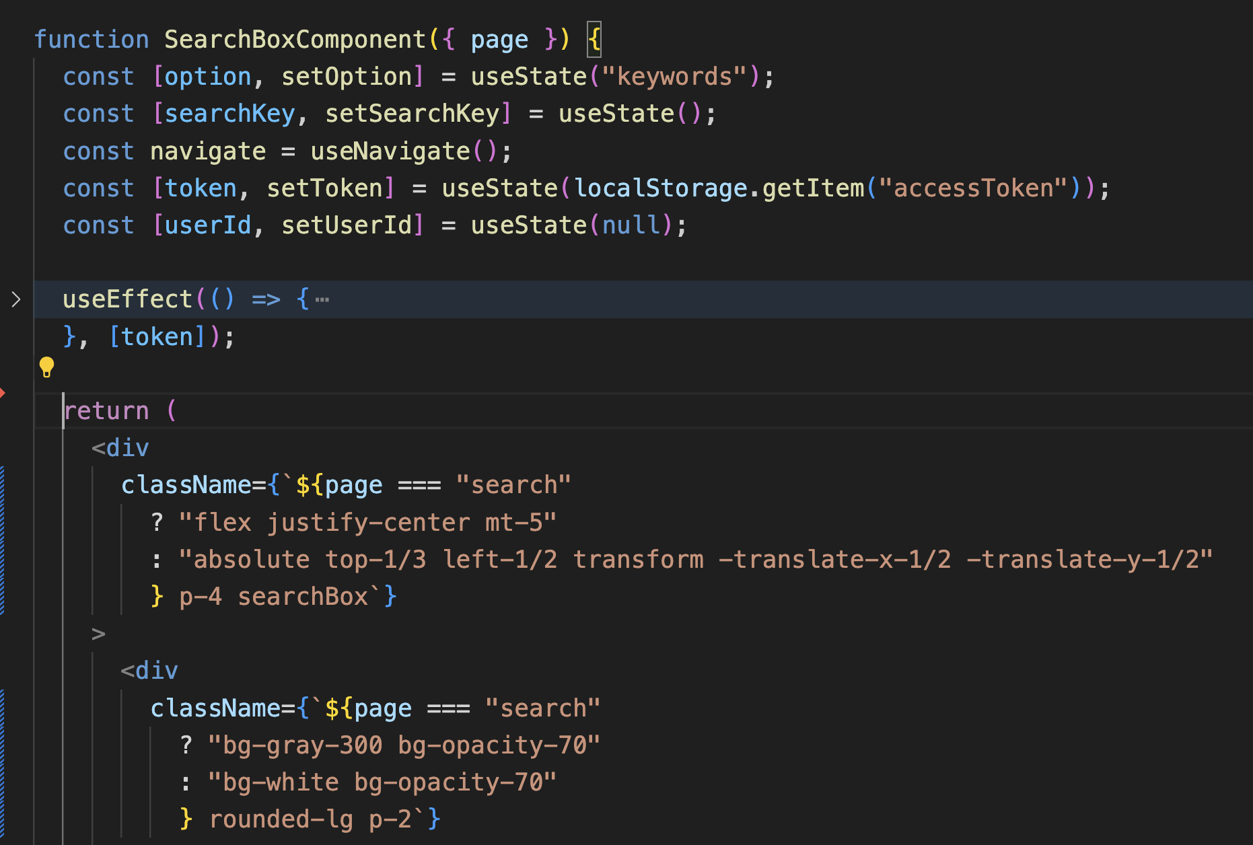
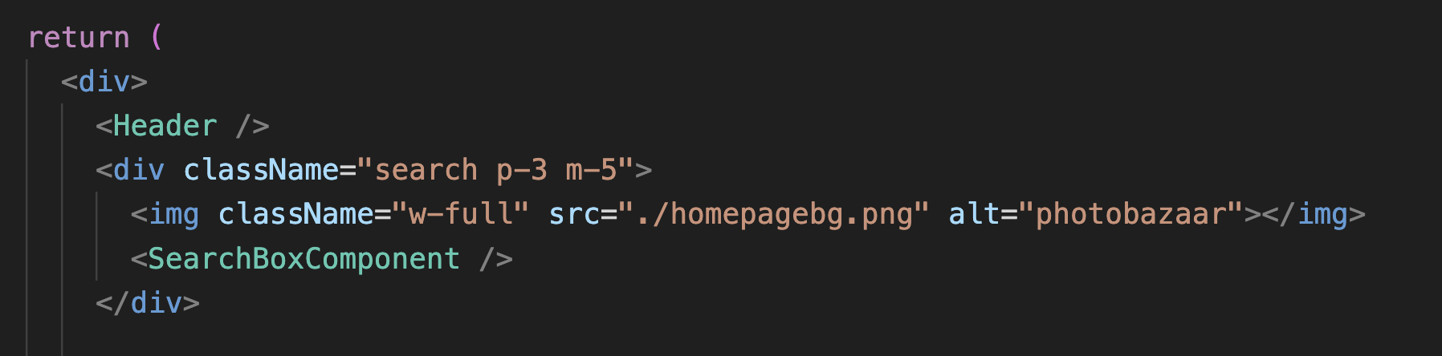
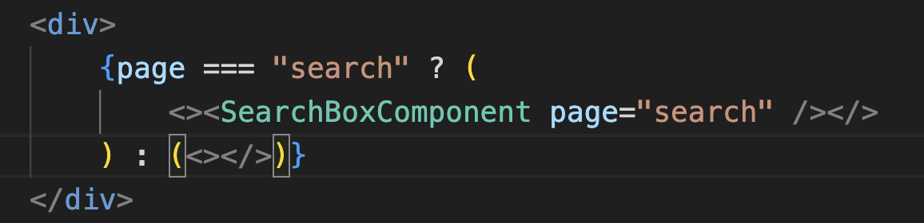
Search Box => Home page/Search Page
SearchBox
Component
Home Page
Search Page

Slide 16
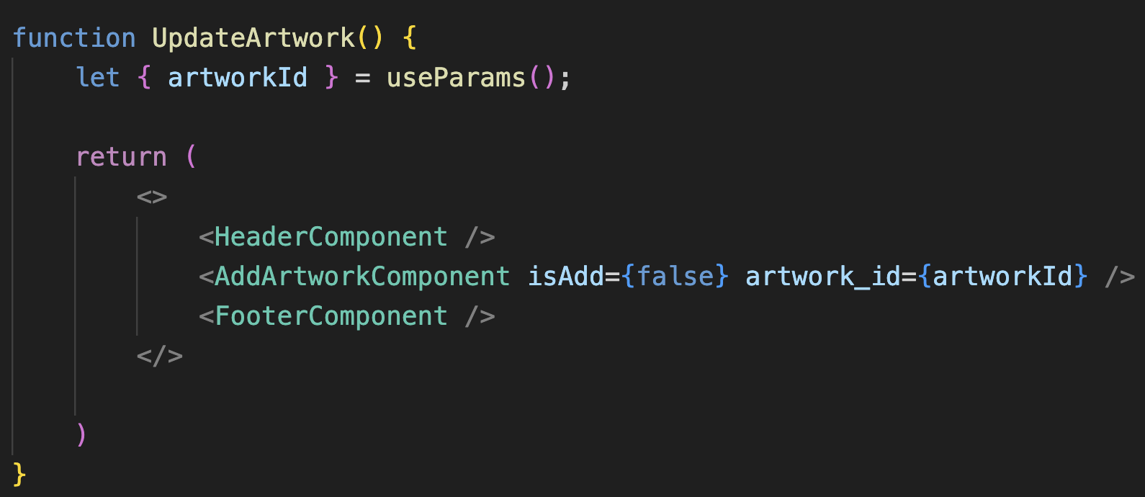
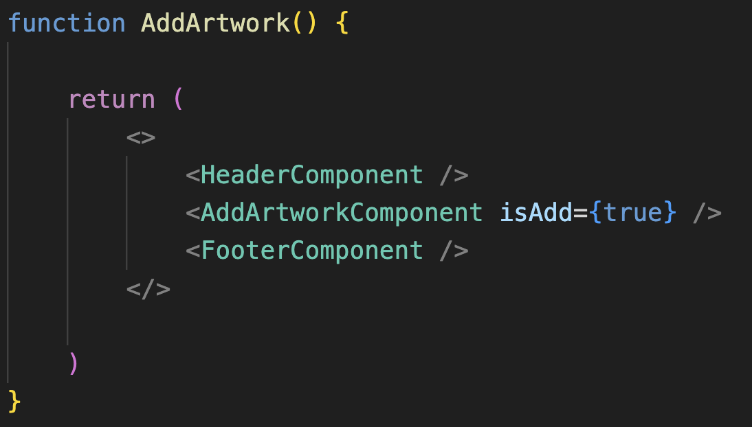
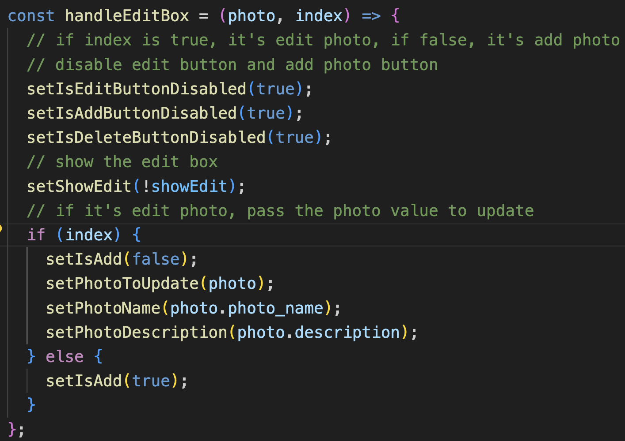
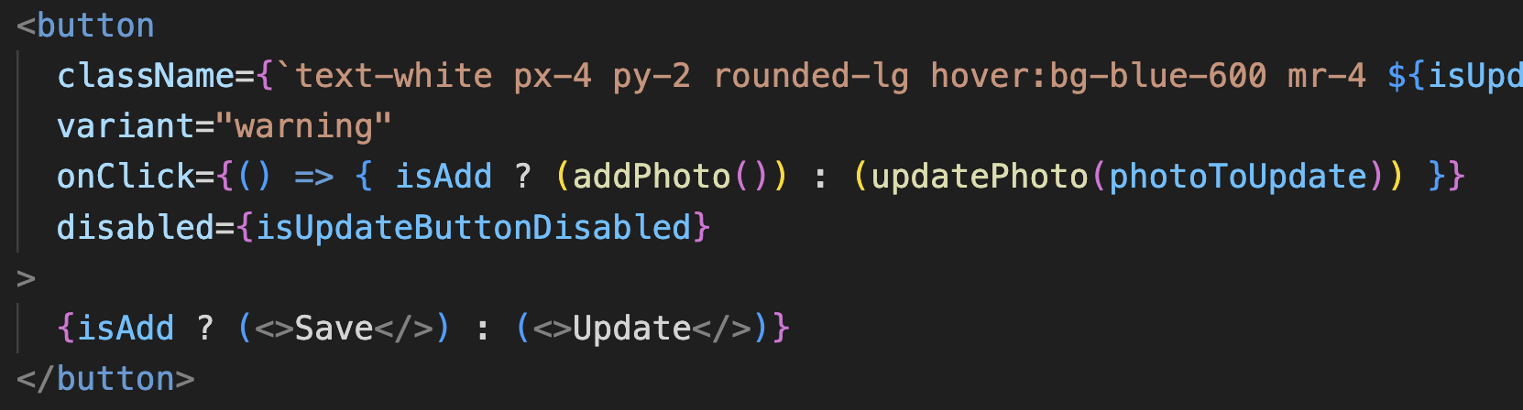
Challenges & Solutions: Make component reusable
AddArtwork => Add/Update Artwork
ArtworkDetails => Add/Update Photo

Slide 17
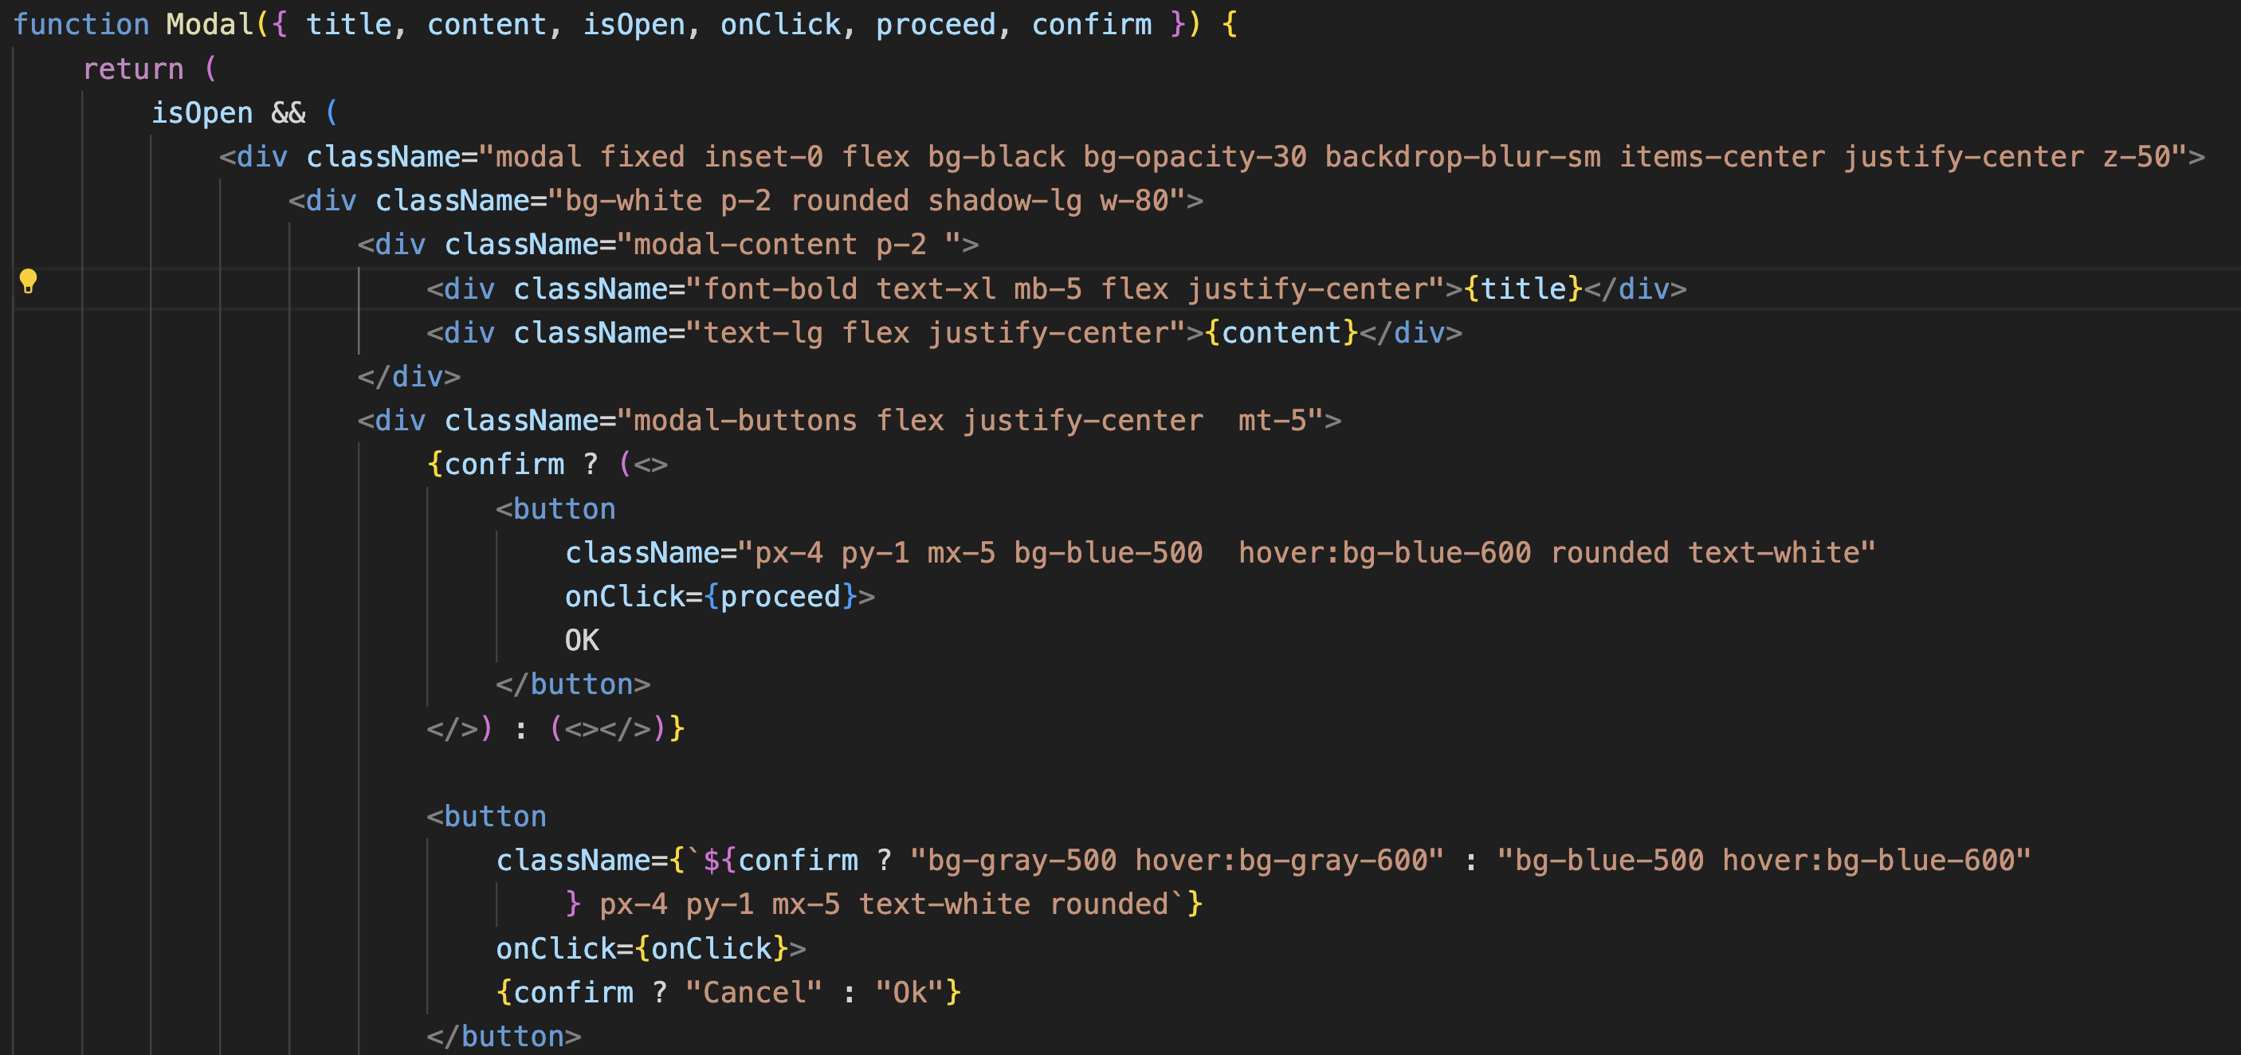
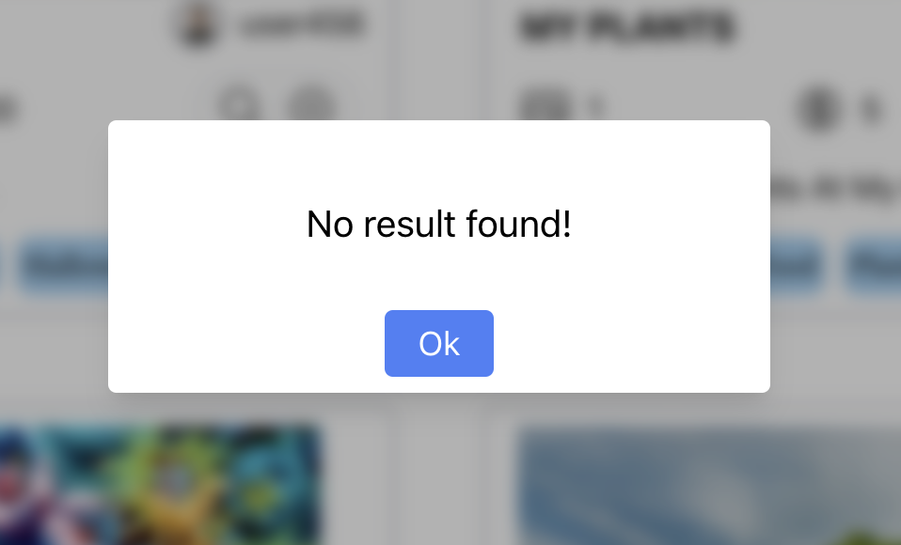
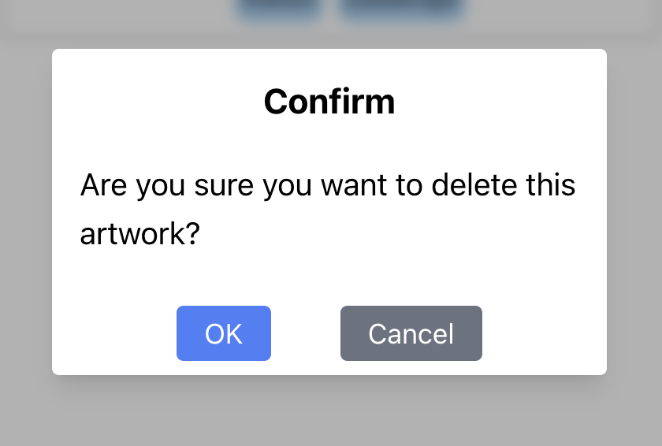
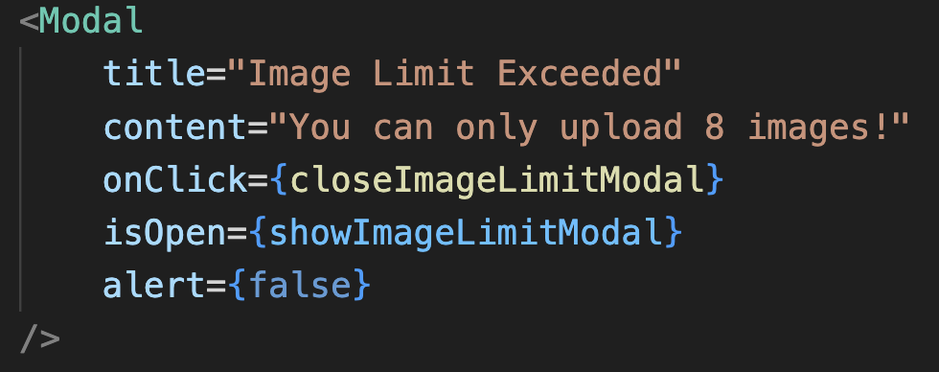
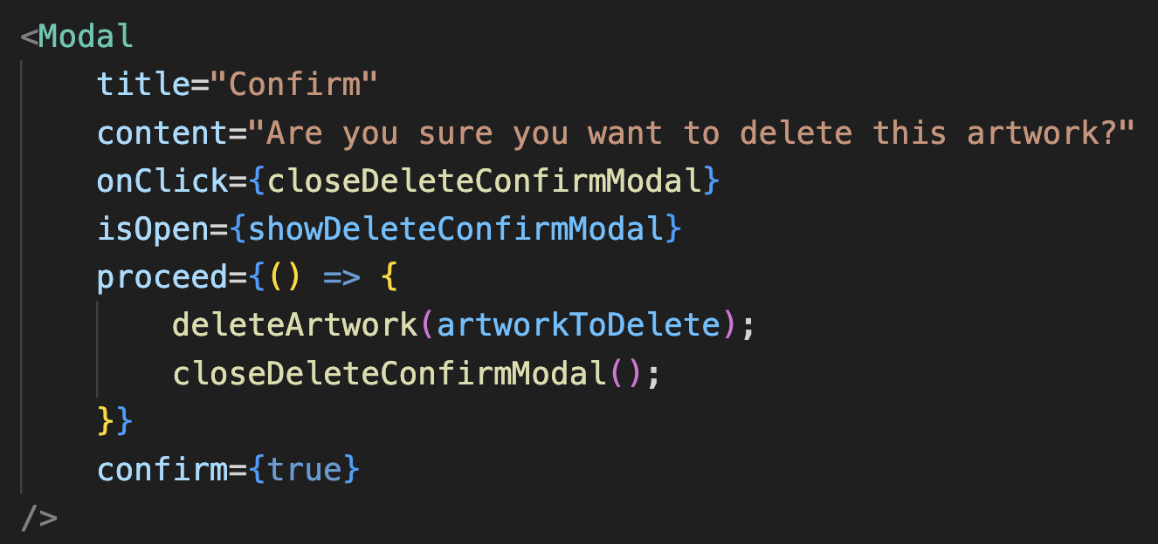
Challenges & Solutions: Make component reusable
Modal

Slide 18
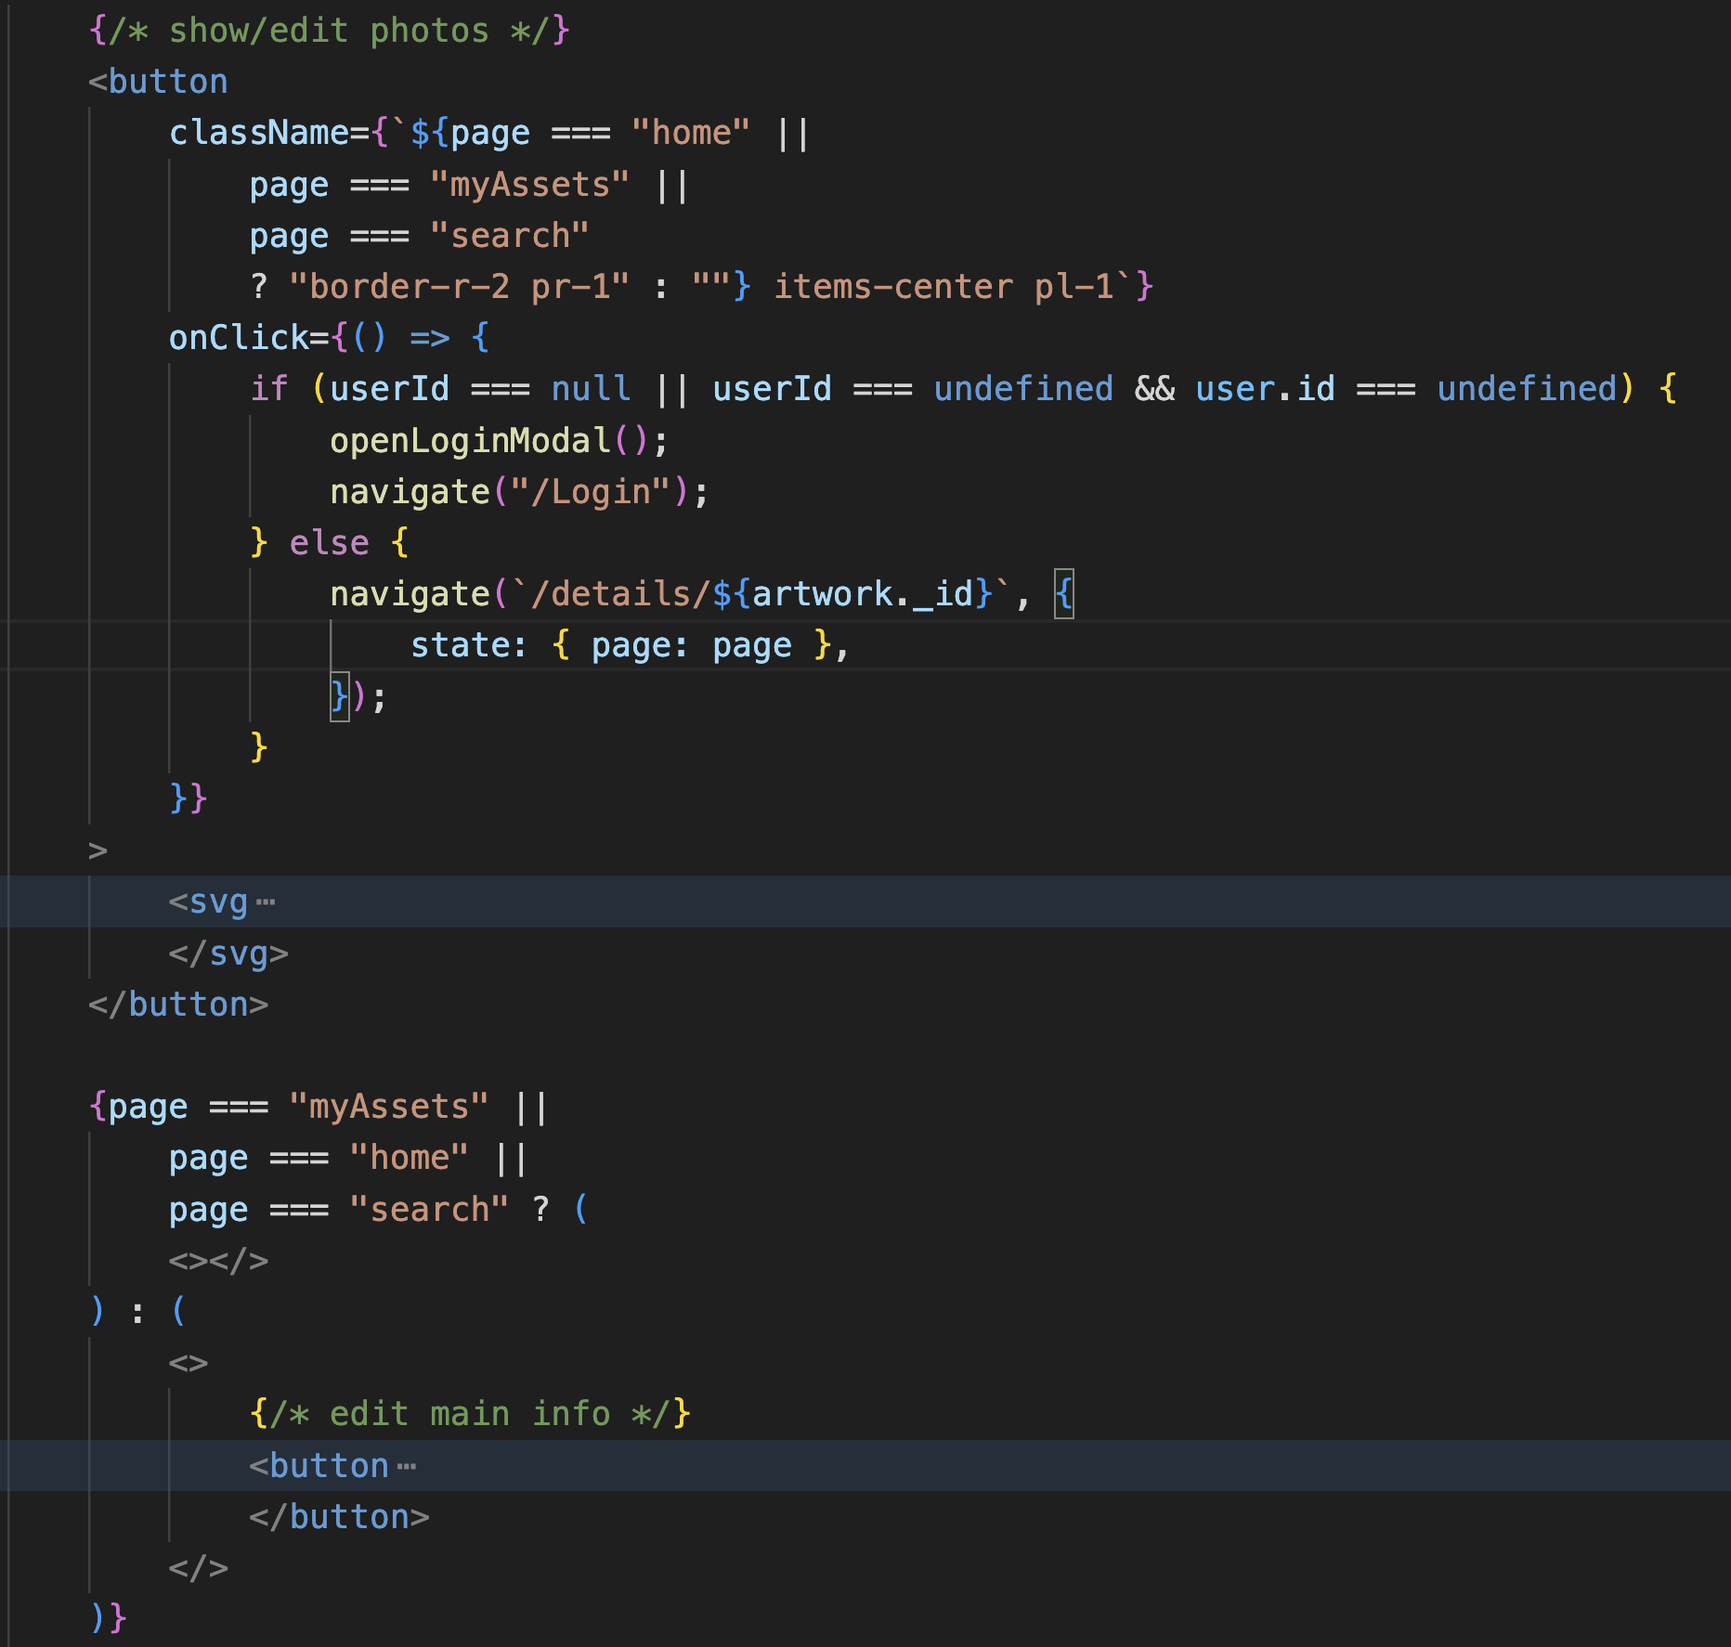


Challenges & Solutions: Make component reusable
ArtworkList => Home page/Search Page/My Artworks Page/ My assets Page
Home/Search Page
My Artwork Page
My Assets Page

Slide 19
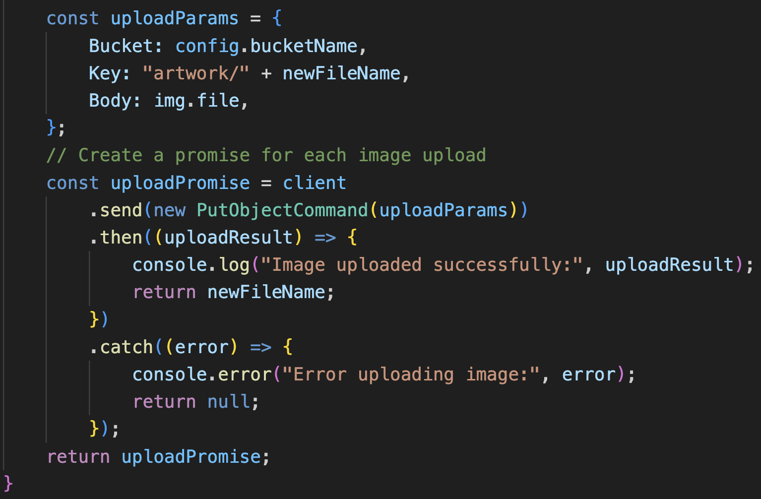
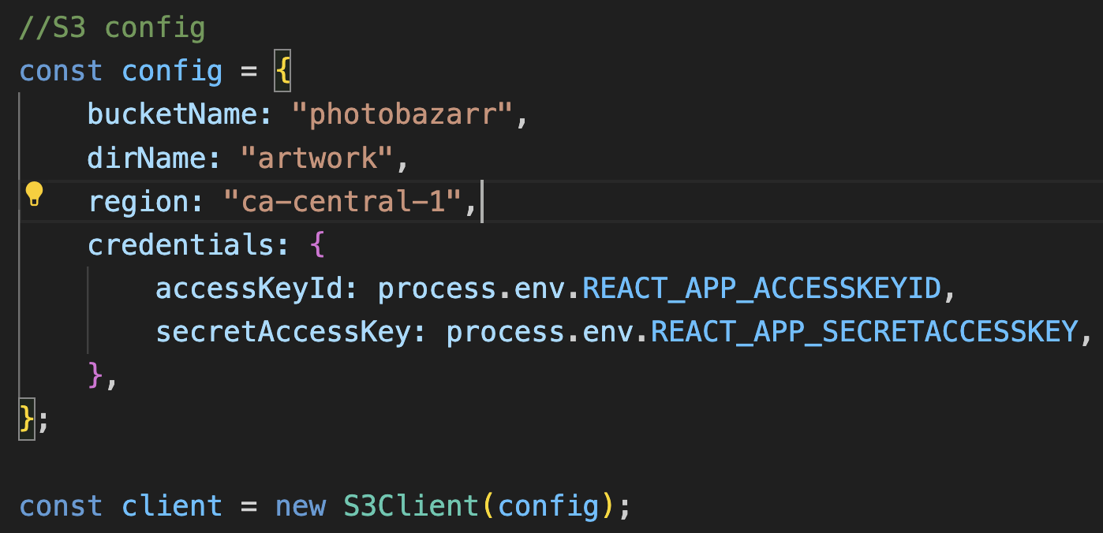
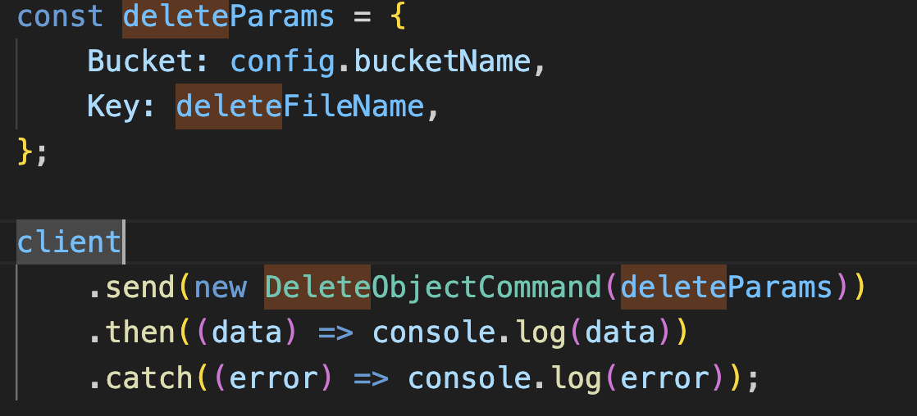
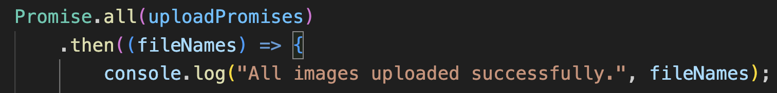
Challenges & Solutions: Upload/Delete Pictures to S3

Slide 20
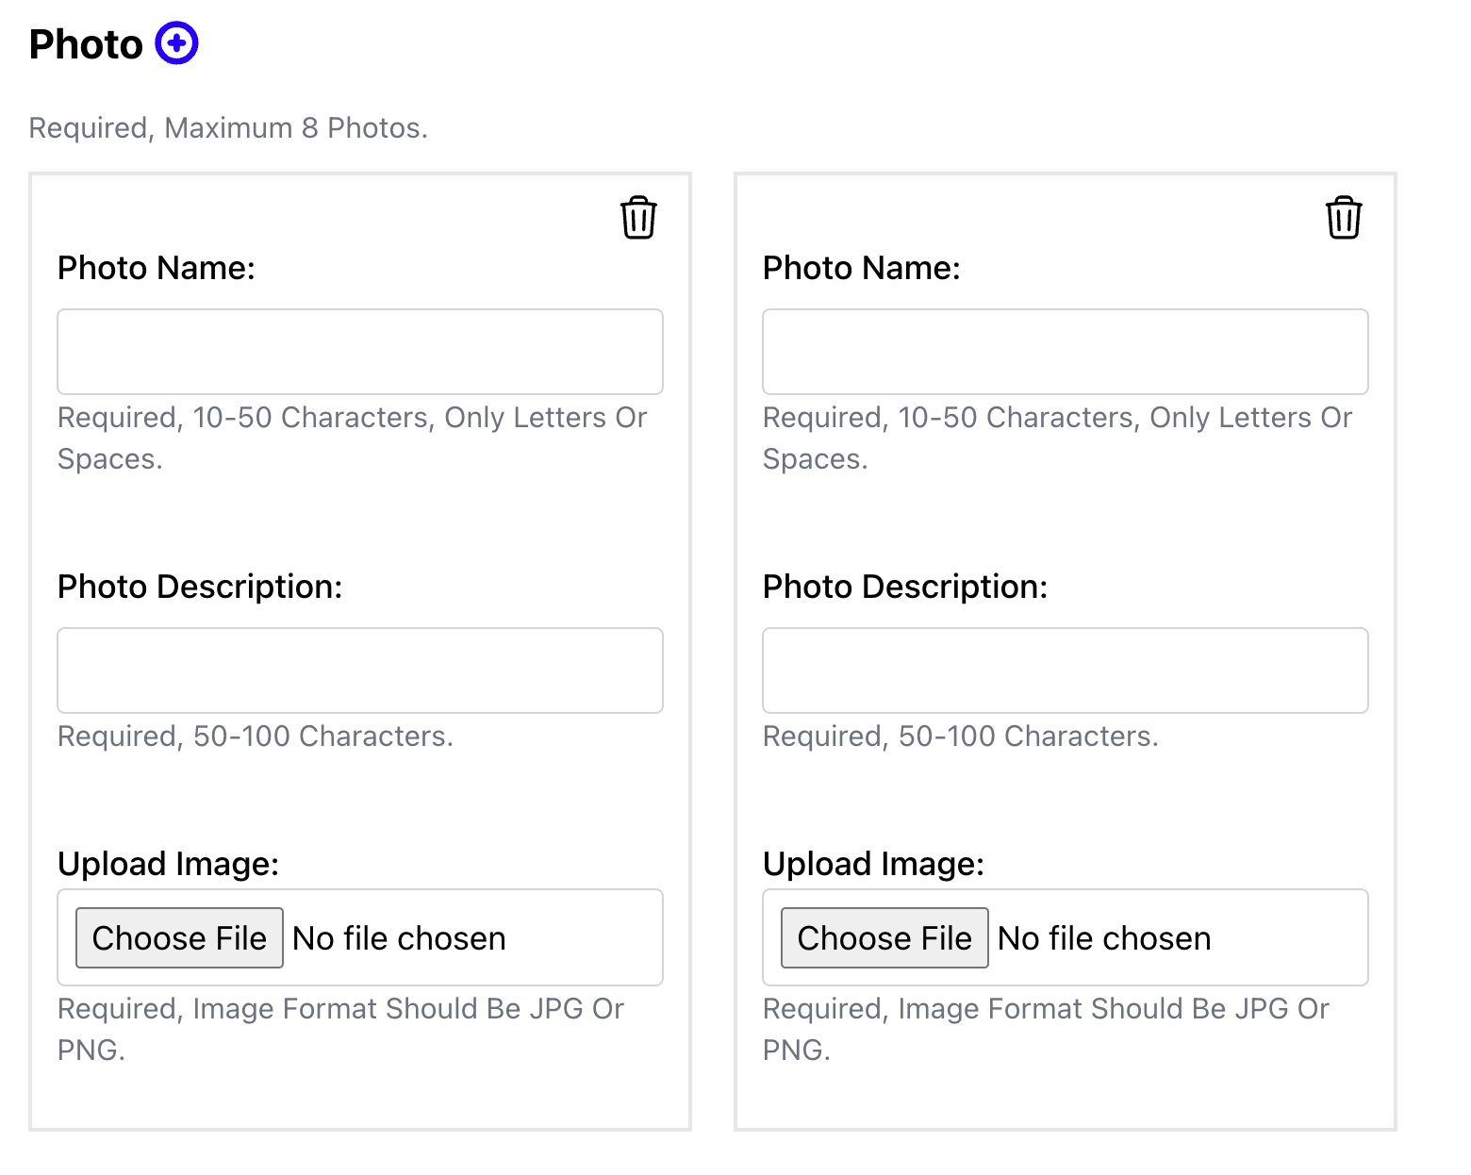
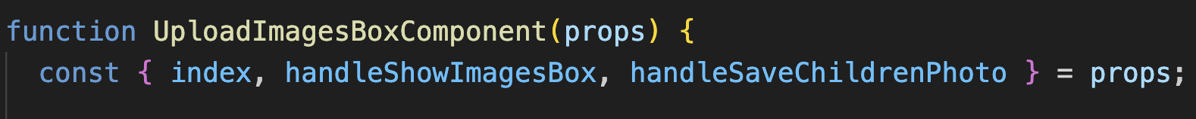
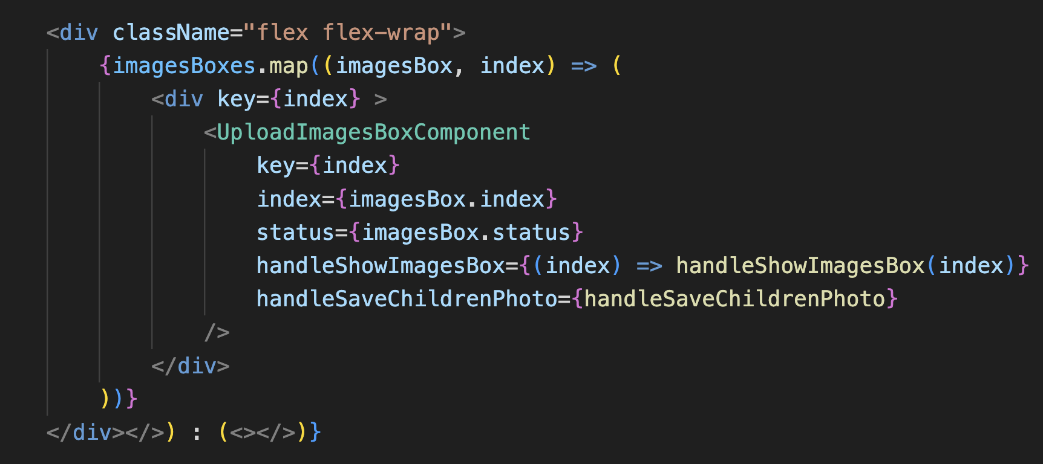
Challenges & Solutions: Parent Component <=> Child Component

Slide 21
What I learnt?
Follow the user feature.
Piece by piece

Slide 22
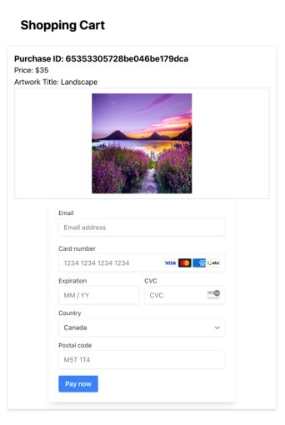

PAYMENT: OVERVIEW

Slide 23
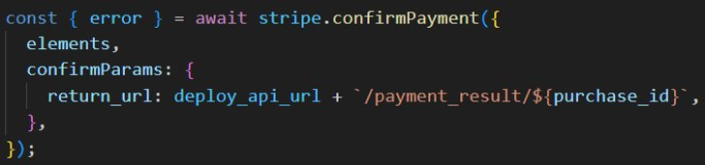
PAYMENT: CHALLENGES&SOLUTIONS
Security & Compliance
Payment Tracking
Stripe
Stripe Checkout
Webhooks
APIs

Slide 24
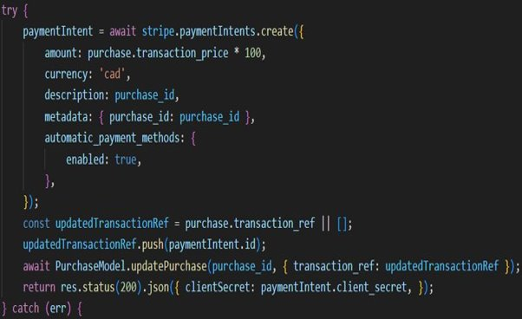
PAYMENT: CHALLENGES&SOLUTIONS
Further challenge: how to obtain comprehensive information​
Payment intent ID
Retry for failed payment
Meta Data
Database updating

Slide 25
PAYMENT: WHAT WE LEARNED
Read the documentation carefully
Docummentation is not everything

Slide 26
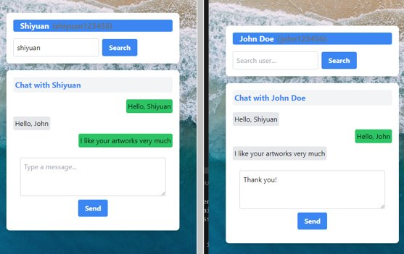
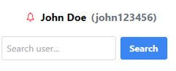
COMMUNICATION: OVERVIEW​

Slide 27
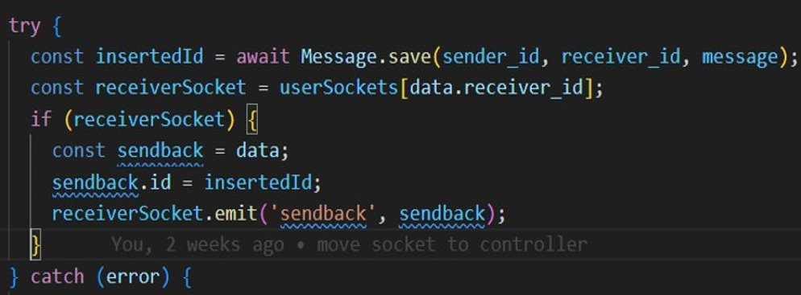
COMMUNICATION: CHALLENGES&SOLUTIONS
Databse synchronization
Real-time chat
Third-party APIs & SDK
MirrorFly, Rocket.Chat, Twilio, Apphitect …
WebSocket protocol
Socket.io
Message History
Reading Status
Notification

Slide 28
SUMMARY & FUTURE WORK
Integrate accounting functions​
Such as withdrawal, refund and report

Slide 29



OUR TEAM
SHIYUAN XU
XIAOXING PAN
CHANG LIU

Slide 30
THANKS!
Do you have any questions?
PHOTOBAZAAR.VERCEL.APP

